Slide 1
OMNeT++ Simulation Project
Dylan White
Gus Ellerm

Slide 2
Difficulties
Cross-platform development
  Default makefile configuration
  File naming
Makefiles
  IDE vs. command line
  Dynamic linking
Memory management
  Deleting message objects
  Destructors
RNG
  Seed generation

Slide 3
Testing
Visual debugging
  Checking message sequencing makes sense
Valgrind – memcheck
  Checking for non-obvious memory leaks
GDB debugger
  Finding exact locations simulation was breaking
Analysing statistics
  Are the results explainable?
  Do they make sense?

Slide 4
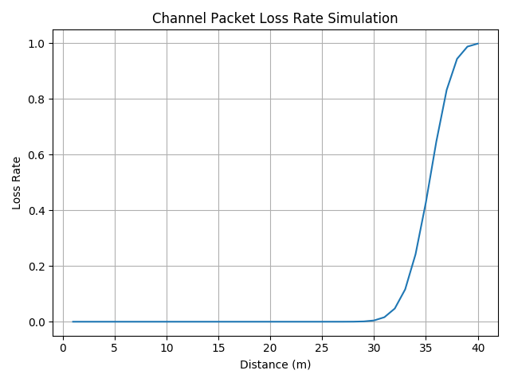
Channel Packet Loss Rate

Slide 5
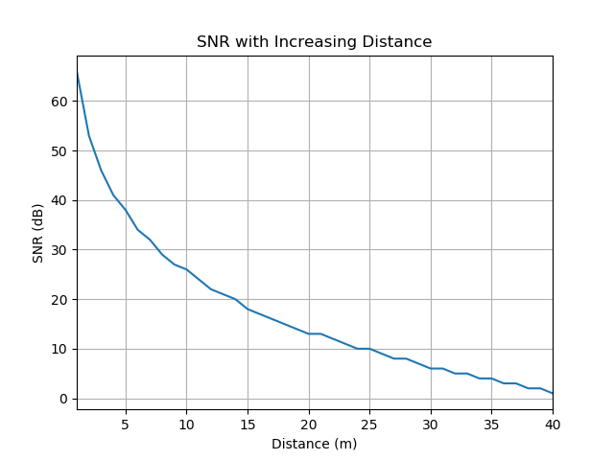
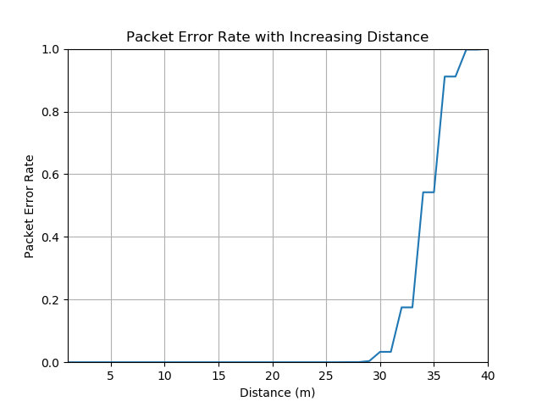
Channel Packet Loss Rate

Slide 6
MAC Packet Loss Rate

Slide 7
MAC Packet Loss Rate

